Slide 1
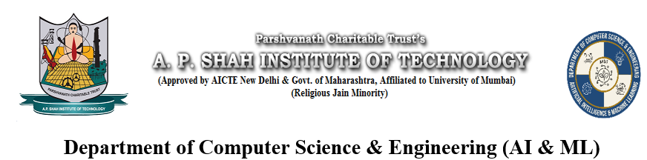
INVESTMENT BANKING CHATBOT USING RAG
Yash Penkar (22106118)
Prarthana Patil (22106035)
Rutuja Pawar (22106043)
Nikita Patil (22106081)
Under the Guidance of
Prof. Taruna Sharma

Slide 2
OUTLINE
Introduction
Literature Survey of the Existing Systems
Limitations of the Existing Systems
Problem Statement
Proposed System Design
Framework/Algorithm
Technologies Stack for Proposed System
Details of Database / Input to the System
Implementation(Partial)
Conclusion
References

Slide 3
INTRODUCTION
Investment banker chatbots leverage AI and machine learning to transform financial services delivery.
These chatbots use NLP and data analytics to provide an interactive user experience.
They can perform tasks traditionally handled by human financial experts, including portfolio management and market trend analysis.
By analyzing large financial datasets, they offer personalized investment recommendations with high accuracy.
Investment banker chatbots improve efficiency, reduce costs, and provide 24/7 financial advisory support.
They democratize access to financial expertise, offering tailored insights to both novice and experienced investors.
These chatbots are expected to play a crucial role in the future of financial advisory services.

Slide 4
LITERATURE SURVEY OF THE EXISTING SYSTEM
[1] Smart Banking Chatbot: International Journal for Research in Applied Science & Engineering Technology (IJRASET) ISSN: 2321-9653; IC Value: 45.98; SJ Impact Factor: 7.538 Volume 10 Issue IV Apr 2022.
Implementation of the project would make the user experience of a customer on the website, more friendly and seamless. A chatbot can also act as an information-gathering tool that would help the organizations to inspect the needs of customers and then implement them. In the banking domain, contextual assistants need to cover more Indian languages thereby increasing the usability of chatbots.
[2] Banking Chatbot Using NLP And Machine Learning Algorithms: International Research Journal of Engineering and Technology (IRJET) e-ISSN: 2395-0056 ,Volume: 10 Issue: 05 ,May 2023.
The Bank Chatbot using NLP and Machine Learning is a promising solution for the banking industry to improve customer service and automate various banking processes. The performance of the system can be further improved by using advanced machine learning algorithms such as Naive Bayes having 90.6% accuracy.

Slide 5
[3] Smart Chatbot System for Banking using Natural Language Processing Tools: National Open University of Nigeria,2023.
The research focused on developing a smart chatbot system for banking using NLPTK to provide accurate and accessible banking information. The chatbot had a user-friendly web interface. Testing showed 97% response accuracy and spelling error detection. It had a separate back end for administrators. Limitations included occasional incorrect answers, lack of system memory leading to repetitive responses, and no anaphora resolution.
[4] Text-Based Chatbot in Financial Sector: A Systematic Literature Review Article in Data Science in Finance and Economics· DOI: 10.3934/DSFE.2022011 July 2023.
The current study highlights the key benefits of implementing chatbots in the financial sector, such as improved decision-making, customer service, productivity, efficiency, resource management and more. Significant influential factors have also been identified when implementing a chatbot. It was also noted that the security and privacy vulnerabilities of chatbots in the financial sector should be considered and analyzed before deployment.

Slide 6
[5] Transforming Finance Through Automation Using AI-Driven Personal Finance Advisors: 4th International Conference on Computation, Automation and Knowledge Management (ICCAKM), IEEE,2024.
The research covers challenges like budgeting, investment planning, debt management, and retirement preparation. It highlights AI's capabilities in data- driven analysis, predictive modeling, and personalized recommendations, particularly in risk assessment, portfolio optimization, and real-time market monitoring. The paper also addresses ethical and privacy concerns, proposing a transparent deployment framework. User acceptance and trust-building are crucial for widespread adoption. A case study demonstrates enhanced financial literacy, returns, and overall well-being with AI-powered advisors, underscoring their potential to revolutionize financial wellness.
[6] Exploring the Impact of AI-Powered Chatbots in Banking Services: Ninth International Conference on Science Technology Engineering and Mathematics (ICONSTEM), IEEE,2024.
The study aims to examine how using bank chatbots affects customer satisfaction. It also aims to investigate how customer satisfaction impacts trust and bank reputation. In India, 324 clients who have utilized chatbots for financial transactions are participating in a survey. The results offer new perspectives on the channels through which banking services are delivered, which could be helpful to experts, scholars, bank executives, product development teams and design teams.

Slide 7
[7] Conversing with AI chatbots: examining what OpenAI ChatGPT-4, Microsoft Bing Chatbot, and google bard know, think they know, do not know, and would like to know about engineering: J. Umm Al-Qura Univ. Eng.Archit,2024.
Brief examination clearly notes that chatbots can provide logical and domain- related information that agrees, for the most part, with that commonly accepted in the engineering domain. The same also alludes to the fact that these chatbots, despite being in their early release days, could serve as virtual assistants to users (i.e., academics, etc.) While some chatbots continue to acknowledge their limitations and AI-based nature in addressing some questions, some do not and deliver their answers in a more confident tone. The answers provided by the chatbots herein can be thought of as well put in terms of generalization.
[8] Study of Chatbot In Customer Service at Banking: IEEE,2023.
Chatbots created with AI are one of the most intriguing banking business methods that may lead to the bank winning the contentment vote of their devoted clients. It is projected that chatbots will reduce cost of businesses by about $7.3 billion in the next two years. According to Juniper Research, banks will save 826 million hours through chatbot interactions in 2023.

Slide 8
[9] Web-based chatbot for basic financial and mortgage services: 2nd International Conference on Vision Towards Emerging Trends in Communication and Networking Technologies (ViTECoN),IEEE,2023.
The onset of the chatbot system the experience is like getting your queries resolved by a human but there are no common limitations to the same. Many businesses have developed their own chatbots to help their customers with their needs. Their chatbot is a financial services chatbot which specializes in lending and mortgage services.
[10] Using Chatbot Technologies to Help Individuals Make Sound Personalized Financial Decisions: 2021 IEEE International Humanitarian Technology Conference (IHTC),2022.
Software-based on just-in-time education can make use of nudge theory and gamification to help increase financial literacy while also influencing positive financial behaviour. Using chatbot technology as a conversational interface to this educational software increases convenience and usability, especially among those that struggle with learning to use technology. They present the design for a financial education chatbot that defines core situations for providing suggestions and information to users. Also used a survey to evaluate its usefulness and found that 82 per cent of 68 participants consider the chatbot strongly beneficial to their financial education and behaviour.

Slide 9
LIMITATIONS OF EXISTING SYSTEM
Most systems lack the ability to retrieve relevant information from large, unstructured data sources like PDFs.
Transformer-based models for generating responses are absent in many systems.
Many existing systems do not handle unstructured documents and rely on structured databases.
Few systems are designed specifically for the technical and complex domain of investment banking.
Most systems rely on cloud-based services rather than local model implementations for customization.
Many systems are limited to basic NLP techniques and do not implement advanced text generation.

Slide 10
PROBLEM STATEMENT
Traditional investment advisory services face high costs, delays, and limited accessibility. Financial advisors struggle with increasing client inquiries, leading to slower, costlier services, especially for individuals and small businesses. An AI-powered investment banker chatbot can solve these issues by offering financial insights, handling multiple queries simultaneously, and providing personalized, affordable recommendations. This technology improves decision making, streamlines consultations, and makes expert advice more accessible to all.

Slide 11
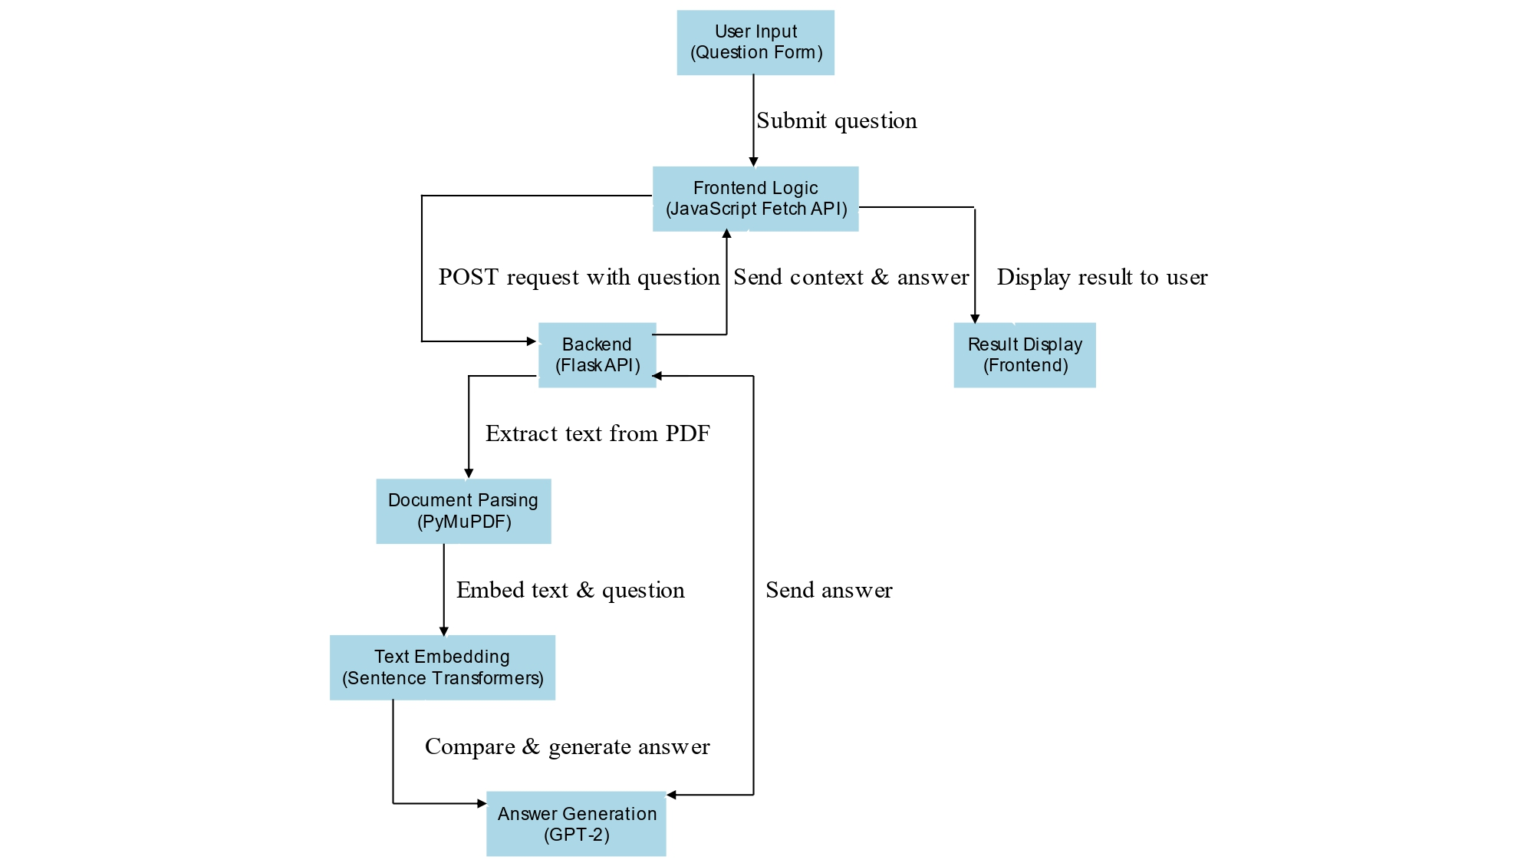
PROPOSED SYSTEM DESIGN

Slide 12
FRAMEWORK/ALGORITHM
1. Define Project Scope and Select Tools
Model Choice:
Use SentenceTransformer (all-MiniLM-L6-v2) for question and document embedding.
Use GPT-2 for natural language generation.
Tool Selection:
Flask for creating a web app and API to serve the chatbot.
PyMuPDF (fitz) for PDF document parsing and text extraction.
Sentence Transformers for encoding and similarity comparison.
Transformers (GPT-2) for generating responses.

Slide 13
2. Setup and Configuration
Initialize Model:
Load the pre-trained SentenceTransformer model (all-MiniLM-L6-v2) for embedding questions and documents.
Initialize the GPT-2 model for text generation.
Setup Libraries and Tools:
Install and import required libraries: Flask, PyMuPDF, SentenceTransformer, and transformers.
Setup a basic Flask server for handling requests and responses.
3. Define and Implement Chunking Strategy
Document Processing: Use PyMuPDF to extract text from the PDF and split the document into sentences.
Vector Store Creation: Encode each sentence into vectors using SentenceTransformer and store these embeddings for quick retrieval.

Slide 14
4. Develop the Backend Application
Build Flask App: Create the Flask application (app.py) to serve as the backend of the chatbot, with API endpoints to handle user queries.
Integrate Front-End: Connect the backend to the frontend via HTML, CSS, and JavaScript (index.html, styles.css, script.js) for question input and response display.
5. Implement Retrieval-Augmented Generation (RAG)
Load Vector Store: Load the precomputed sentence embeddings from the PDF into memory.
Setup Retrieval QA Chain: For each user query, compute its embedding and retrieve the most similar sentence from the stored vector store.
Create Retriever: Implement cosine similarity scoring to find the best matching sentence from the document, which acts as the "retriever" in the RAG system.

Slide 15
6. API Development and Integration
Create API Endpoints: Create an /ask endpoint in Flask to handle POST requests with user questions.
Handle Requests: Parse the incoming JSON payloads, process the question, retrieve the relevant context from the document, and generate a response using GPT-2.
7. Testing and Validation
Functionality Testing: Test the chatbot's ability to answer different types of questions based on the document and verify if the generated responses are accurate and contextually relevant.
Address Limitations: Adjust response generation and context retrieval in case of repetitive or irrelevant information. Test for edge cases where the system may fail.

Slide 16
TECHNOLOGY STACK FOR PROPOSED SYSTEM
Technologies:
Flask: A lightweight web framework used for building the server-side API to handle user requests, load the PDF, and return responses.
PyMuPDF (fitz): Used for extracting text from a PDF document (e.g., 400 Questions & Technicals.pdf), which serves as the knowledge base for the chatbot.
Sentence Transformers (all-MiniLM-L6-v2): A pre-trained model used to encode the question and the sentences from the PDF into vector embeddings to calculate semantic similarity.
Transformers (GPT-2): Utilized for generating natural language responses based on the context retrieved from the PDF using a pre-trained GPT-2 model.
HTML/CSS/JavaScript: Frontend technologies for creating the user interface where the user can input questions, and the chatbot can display results.

Slide 17
Methodologies:
1. Retrieval-Augmented Generation (RAG):
Combines information retrieval and natural language generation to provide contextually relevant responses.
The chatbot retrieves relevant sections of the PDF document based on semantic similarity using the sentence transformer model, then generates answers using GPT-2.
2. Semantic Search:
Questions are converted into vector representations using Sentence Transformers.
Relevant sections from the PDF are retrieved by computing cosine similarity between the question embedding and the document embeddings.
3. Text Generation:
A prompt is created using the retrieved context and user question, and GPT-2 generates the final answer.
GPT-2 is used to handle natural language generation based on the input prompt, ensuring responses are coherent and contextually accurate.

Slide 18
Details of Database / Input to the System
400 Questions & Technicals.pdf:
This document, titled 400 Questions & Technicals, contains a wide range of investment banking-related interview questions and answers, specifically focused on technical financial concepts such as accounting, valuation, and modeling .To integrate this into your Investment Banking Chatbot using RAG (Retrieval-Augmented Generation), the document can serve as a crucial resource for generating responses to various technical financial questions.
Source: GitHub

Slide 19
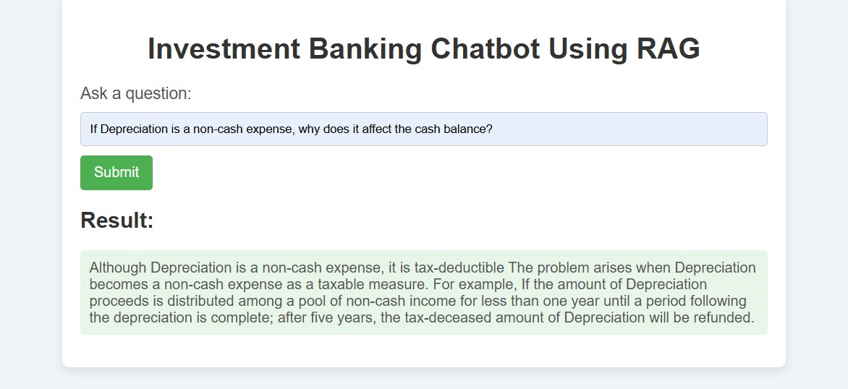
IMPLEMENTATION

Slide 20
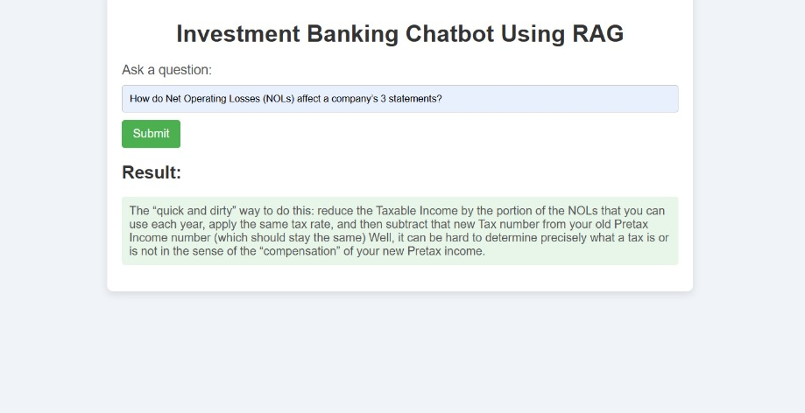
IMPLEMENTATION

Slide 21
CONCLUSION
The chatbot efficiently retrieves relevant information from PDF documents using a SentenceTransformer model.
It generates context-aware responses utilizing a local GPT-2 language model.
The system enhances user experience by providing on-the-fly answers to investment banking queries.
This implementation showcases the integration of NLP and deep learning for specialized knowledge retrieval in finance.

Slide 22
REFERENCES
[1] Smart Banking Chatbot: International Journal for Research in Applied Science
& Engineering Technology (IJRASET) ISSN: 2321-9653; IC Value: 45.98; SJ Impact Factor: 7.538 Volume 10 Issue IV Apr 2022.
[2] Banking Chatbot Using NLP And Machine Learning Algorithms: International
Research Journal of Engineering and Technology (IRJET) e-ISSN: 2395-0056, Volume: 10 Issue: 05 ,May 2023.
[3] Smart Chatbot System for Banking using Natural Language Processing Tools: National Open University of Nigeria,2023 .
[4] Text-Based Chatbot in Financial Sector: A Systematic Literature Review Article in Data Science in Finance and Economics· DOI: 10.3934/DSFE.2022011
July 2023.
[5] Transforming Finance Through Automation Using AI-Driven Personal Finance Advisors: 4th International Conference on Computation, Automation and Knowledge Management (ICCAKM), IEEE,2024.

Slide 23
REFERENCES
[6] Exploring the Impact of AI-Powered Chatbots in Banking Services: Ninth International Conference on Science Technology Engineering and Mathematics (ICONSTEM), IEEE,2024.
[7] Conversing with AI chatbots: examining what OpenAI ChatGPT 4, Microsoft Bing Chatbot, and google bard know, think they know, do not know, and would like to know about engineering: J. Umm Al-Qura Univ. Eng.Archit,2024.
[8] Study of Chatbot In Customer Service at Banking: IEEE,2023.
[9] Web-based chatbot for basic financial and mortgage services:2nd International Conference on Vision Towards Emerging Trends in Communication and Networking Technologies (ViTECoN),IEEE,2023.
[10] Using Chatbot Technologies to Help Individuals Make Sound Personalized Financial Decisions: 2021 IEEE International Humanitarian Technology Conference (IHTC),2022.

Slide 24
THANK YOU

